Slide 1
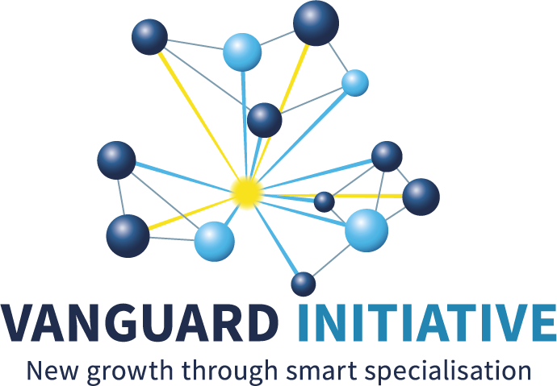
Hydrogen Pilot Summit 18th November 2024 Demo case: H2 Networks and Portfolios
Lombardy region
Fabrizio Guarrasi,
Innovation Manager at
Lombardy Energy Cleantech Cluster – LE2C

Slide 2
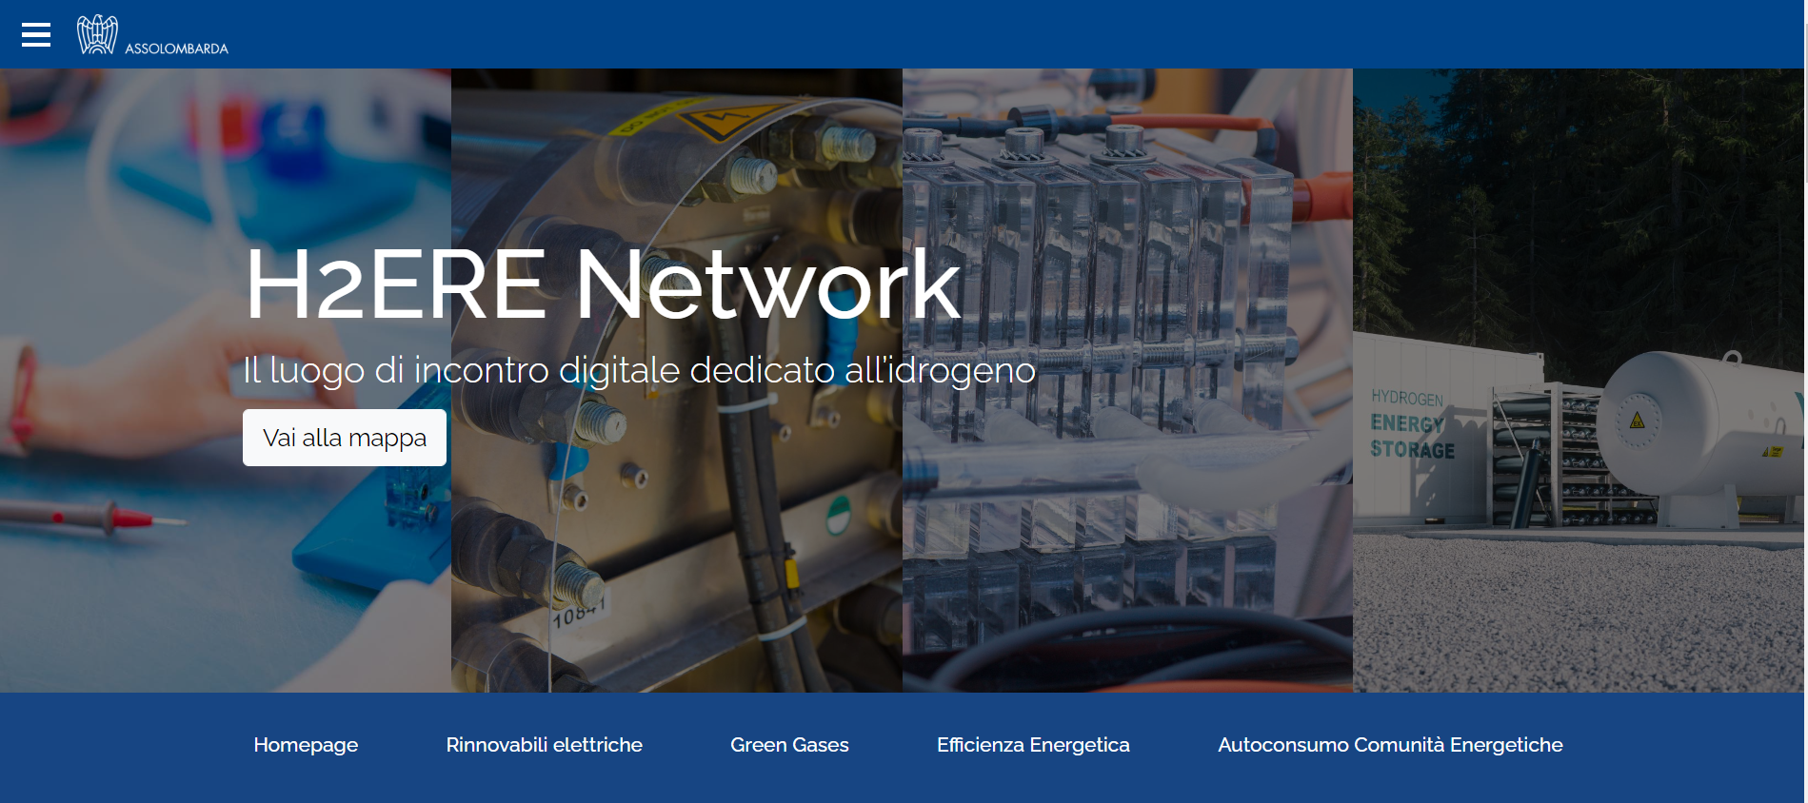
Networking & Portfolios From where it began
LE2C Cluster (as Lombardy representative) launched the H2ERE Network (Hydrogen Energy Research and Enterprise Network) project’s working web platform in 2023.
H2ERE Network is an interactive map that allows companies to identify and contact the laboratory or research center for their need in developing and testing innovative hydrogen-related solutions.
In 2025, the platform will also be expanded at the EU level.

Slide 3
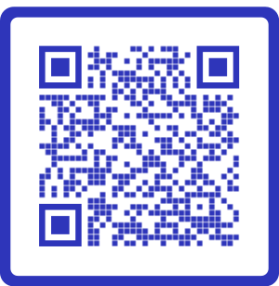
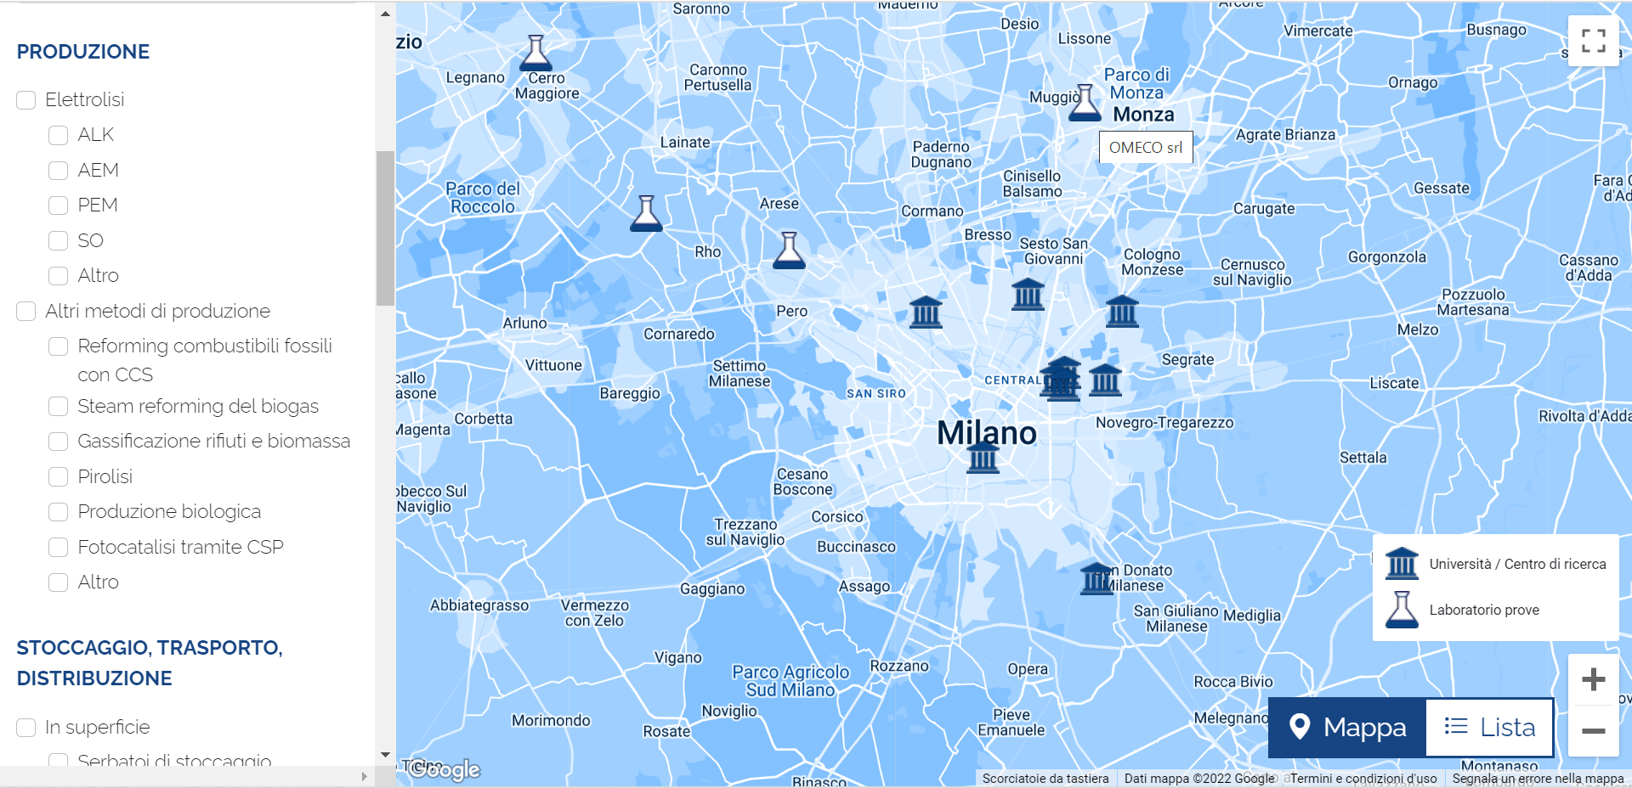
Networking & Portfolios From where it began
Hydrogen Energy Research
and Enterprise
Network
Notes:
Last April we, as LE2C Cluster and Lombardy Region, launched a new project “H2ERE NETWORK”, starting from the urgent need to facilitate dialogue between the worlds of research and industry to enhance the development of hydrogen by matching supply and demand.
These considerations led to the idea of creating a networking platform that aims to build a direct link between the worlds of research and industry. Facilitating the matching between companies that want to invest in the field of hydrogen, and universities, research centres and private laboratories that have the necessary infrastructure and know-how for the hydrogen technology development.
Industries, thanks to an interactive map and a list of keywords linked to the field of application (production, transport, storage, end uses, ...) , will be able to find a laboratory that can develop and test their solutions. In parallel, Research Centres and Academia will have a useful tool to make their infrastructures wider available and increase their business.
At the moment the platform is available only in Lombardy but we are working to expand it at National and, in the future, European level. And I think that this Pilot may be an interesting opportunity to achieve it.

Slide 4
H2 networks & portfolios
An introduction

Slide 5
Networking & Portfolios Introduction
Boost the interregional collaboration between companies and RTOs inside our Pilot and promote our regions’ SMEs and our R&I centers that are developing H2 solutions.
Help SMEs and Research to diversify into the hydrogen sector.
Help them share their knowledge and infrastructures to co-participate in developing new hydrogen projects at the European level.
Enable new collaborations for SMEs in research, projects, and funding
Leading region: Lombardy
Leading organization: Lombardy Energy Cleantech Cluster
N° regions involved: 5 (Lombardy, Scotland, Wales, Malopolska and Slovenia)

Slide 6
How we do that? Survey – made with Scotland
Regions involved in the survey: 15
Aragon
Asturias
Emilia Romagna
Friuli Venezia Giulia
Galicia
Gavleborg
Lombardy
Lower Austria
Lower Saxony
Malopolska
Norte
Saxony
Scotland
Slovenia
Wales

Slide 7
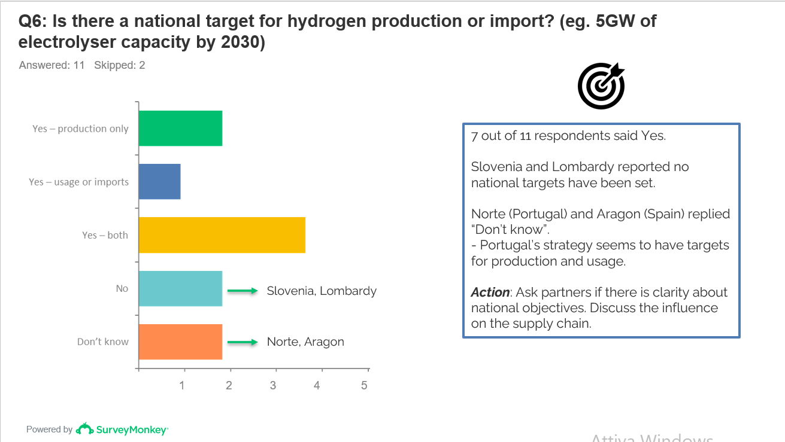
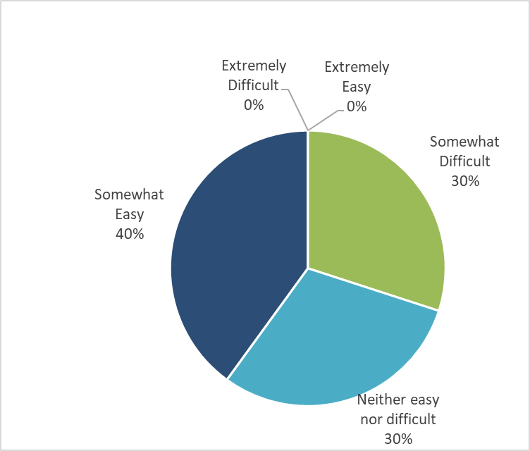
How we do that? Survey
H2 Production
Industrial decarbonisation
Lower Saxony
Scotland
Basque Country
Emilia Romagna
Basque Country
Asturias
FVG
Gavleborg
Wales
Slovenia
Asturias
Gavleborg
Wales
Slovenia
Transport
Lombardy
Basque Country
Storage and distribution
Gavleborg
Lower Saxony
Wales
Scotland
Lombardy
Emilia Romagna
Asturias
Innovation and testing
Basque Country
Lombardy
Wales
Malopolska
Saxony
Asturias
Basque Country
Emilia Romagna
FVG
Emilia Romagna
Saxony

Slide 8
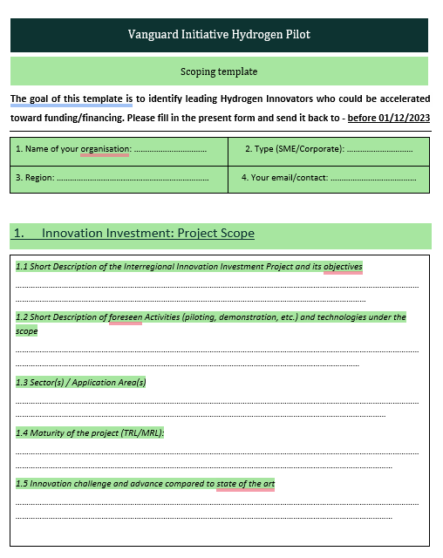
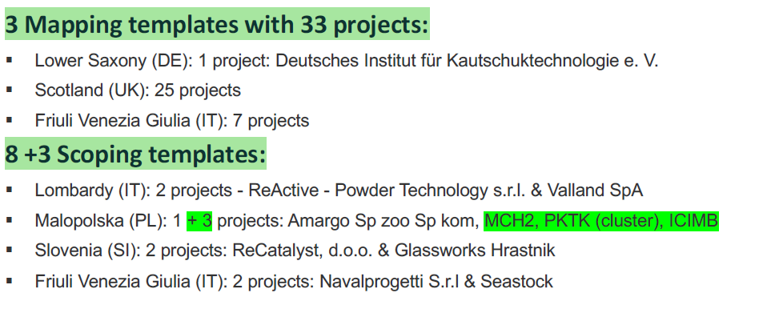
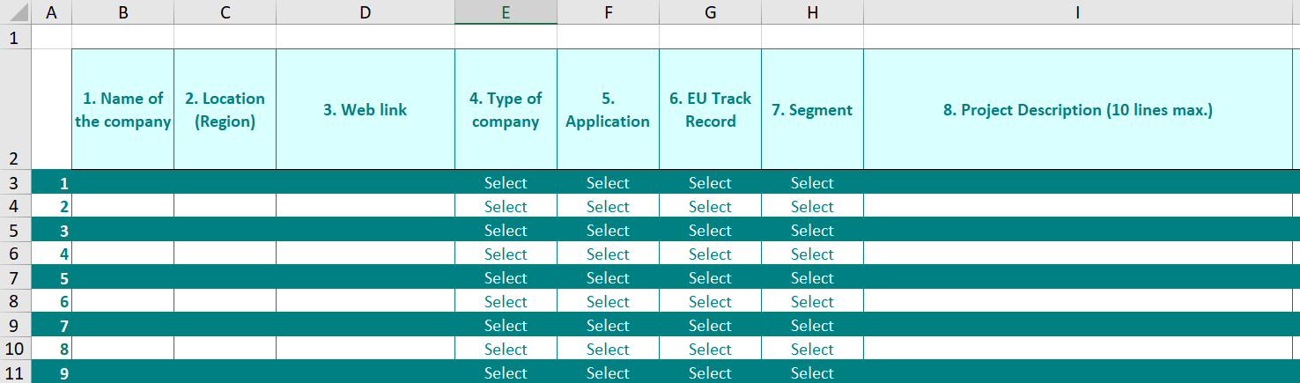
Future opportunities to collaborate Map of H2 Pilot’s use cases

Slide 9
Future opportunities to collaborate Matchmaking event
H2 Pitching & Matchmaking event
1st March 2024
KEY - The energy transition expo
Rimini (Italy)
Presentation of innovative hydrogen projects and matchmaking with hydrogen stakeholders.
Objective: create partnerships to develop EU projects

Slide 10
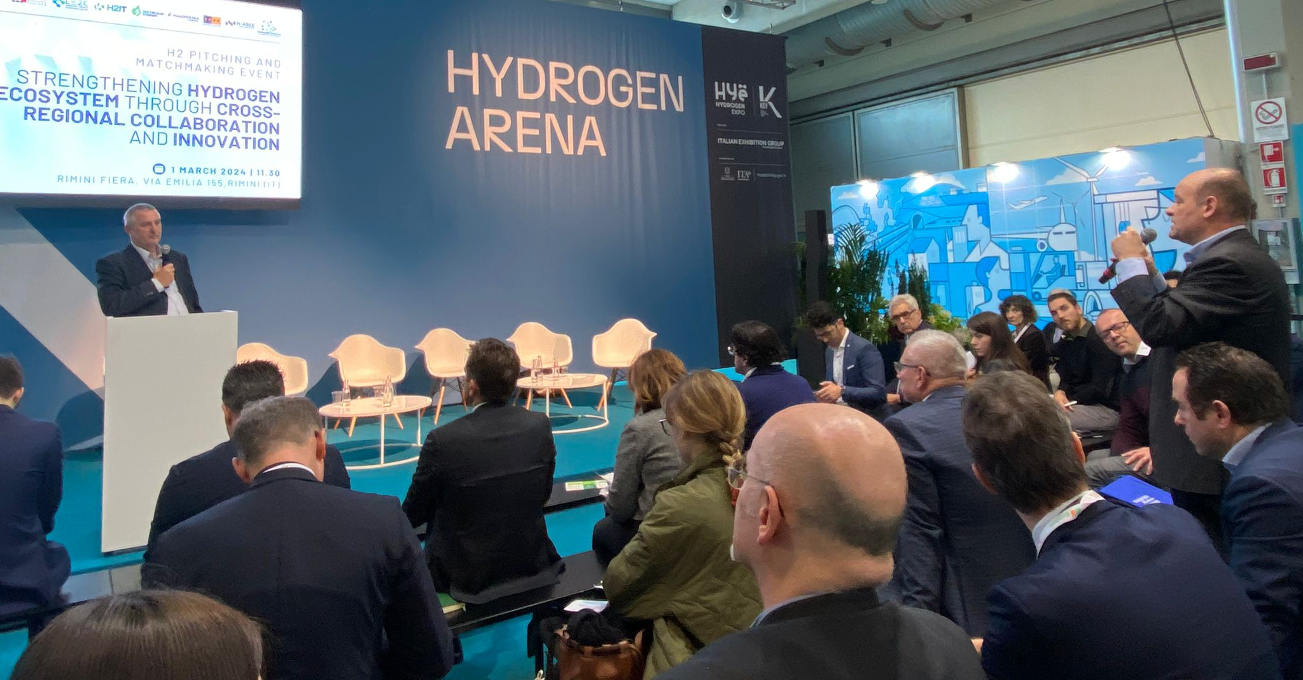
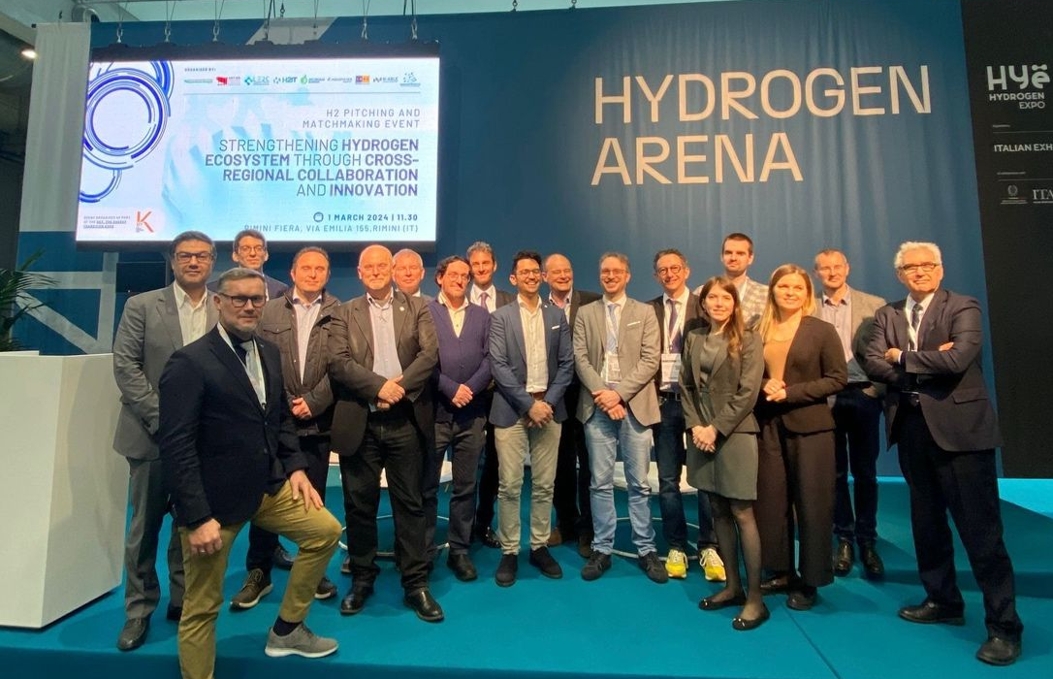
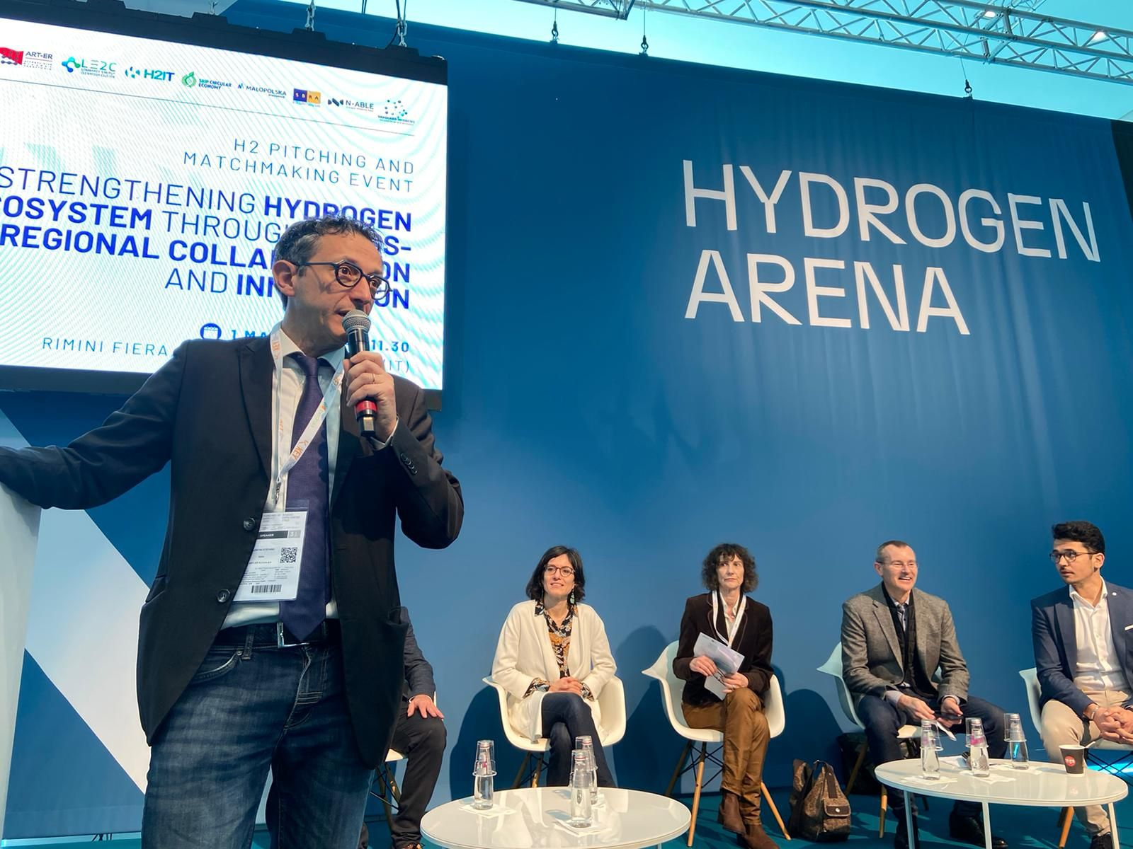
Future opportunities to collaborate Matchmaking event
H2 Pitching & Matchmaking event
Approximately 55 participants
13 selected pitches:
4 Lombardia
4 FVG
2 Slovenia
1 Emilia-Romagna
1 Malopolska
1 Scotland
3 thematic sessions:
Carbon-intensive industries
Production of H2
Maritime application

Slide 11
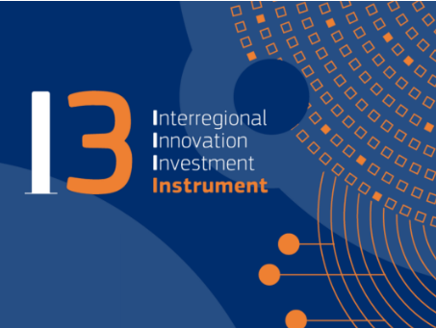
Future opportunities to collaborate Matchmaking event
Post pitching session in Rimini:
10 companies were selected
from Lombardy, Emilia Romagna, FVG, Slovenia, and Malopolska and involved in an I3 project proposal.
Deadline 5th December.

Slide 12
Next steps
Circulate templates for missing regions (regional expertise + H2 projects): regions interested?
Implement our demo case group: regions interested?
Funding opportunities to finance our work and our project
So if you are curious and interested in our Demo, please let us know ☺

Slide 13
Thank you for your attention.
H2 network & portfolios demo case
Lombardy
Fabrizio Guarrasi,
Lombardy Energy Cleantech Cluster (LE2C)
f.guarrasi@energycluster.it

